Slide 1

ReactOS in short
Pierre Schweitzer – pierre@reactos.org
Notes:
Quick intro – 30s
Hello, my name is Aleksey Bragin, I am coordinator of and developer for ReactOS project.
In this talk I’m going to give you a brief overview of ReactOS, components it consists of, technical aspects of the kernel and the bootloader, and perform a small demonstration of what ReactOS really is.

Slide 2

In one slide...
ReactOS is... Like Windows
But, with FOSS philosophy!
Notes:
All – 300 sec
1 - What is ReactOS? – 10 sec
2 – History – 180 sec
Back in the 1970’s and 80’s, the dominant operating system was Unix. However Unix was costly, and out of the reach of your average home user.
In the early 90’s, a computer science student named Linus Torvalds, who was fascinated by hardware and operating systems started a project to rewrite the Unix kernel.
His progress was documented online and quickly aroused the interest of other developers. Development on this free version of Unix grew into what many of you know today as Linux. A dominant presence in the server market, and a potential threat to Windows in the client market.
However, this potential domination in the client market has never really taken hold as the major Linux players continually hope for. Therefore, there is still a huge niche in the market with Microsoft maintaining their stranglehold on end users, at the users cost. This is where ReactOS comes in, with an aim to do with Windows what Linux did with Unix.
ReactOS originally emerged as FreeWin95, encouraged by the growth of Linux, its goal was to write a free implementation of Windows 95. The original project didn’t get very far. There was too much talk about methodologies and not enough coding and it eventually withered away.
In 1997, one of the FreeWin95 developers put out a call out to regroup with a new goal of Windows NT, and an emphasis on writing code as opposed to emails. A new name was decided upon as a reaction to the Windows domination, and ReactOS was born.
The initial years were painfully slow. Low level coding of the kernel mode components was left to specialist developers. With no eye-candy to show to the world, the project remained relatively unknown making it difficult to attract new developers. Initial foundations for the NT kernel and HAL were put in place, and basic generic drivers were written, paving the way for the beginnings of a new operating system.
3 – Complete Windows replacement – 20 sec
ReactOS is an effort to produce a complete rewrite of the Windows NT5 operating system. Thus, ReactOS is not Linux based, but a completely new operating system.
The whole operating system is being written from the ground up, with the entire architecture simulating the NT5 architecture.
We believe most home users are so used to Windows and have become so reliant on it, that a move to a completely different operating system is simply out of the question. There is also the fact that the majority of home users simply don’t have the necessary computer skills to run Linux, or a desire to learn it.
Whilst Linux only provides a kernel with all the other components available as add-ons, ReactOS is a full operating system distribution as Windows is. This means it will not only include system architecture above the kernel, but also apps such as Explorer, Notepad and a paint package.
4 - 100% compatible with Windows – 20 sec
The aim of ReactOS is to take any Windows software off the shelf, and have it successfully install and run in ReactOS. This doesn’t just apply to software such as MS Office or Photoshop, but also applies to games and even drivers.
5 – Licensed under the GPL – 20 sec
The majority of the ReactOS codebase is licensed under the GPL. This means the full source code is available online, and freely available for anyone to download and modify at their leisure. Some parts of the source which have been incorporated from projects such as Wine or BSD are licensed according to their project.
6 – ~20 active developers – 20 sec
Our central code repository is located in Russia and is controlled via a CVS system called SVN. We have active developers from Europe, America and Canada working on ReactOS, and a strong list of contributors from all around the world.
7 – Freely available to everyone – 20 sec
Being that ReactOS is licensed under the GPL, it ensures it will always be freely available, both as in speech, and as in beer.

Slide 3
Thanks for your attention!
Questions?
Notes:
Question time!
A demonstration of ReactOS!

Slide 4
About the speaker
Pierre Schweitzer :
  pierre@reactos.org
  ReactOS (kernel) developer since Nov 2007
  ReactOS sysadmin since July 2011
  AKA : Heis Spiter, pschweitzer
Notes:
All – 300 sec
1 - What is ReactOS? – 10 sec
2 – History – 180 sec
Back in the 1970’s and 80’s, the dominant operating system was Unix. However Unix was costly, and out of the reach of your average home user.
In the early 90’s, a computer science student named Linus Torvalds, who was fascinated by hardware and operating systems started a project to rewrite the Unix kernel.
His progress was documented online and quickly aroused the interest of other developers. Development on this free version of Unix grew into what many of you know today as Linux. A dominant presence in the server market, and a potential threat to Windows in the client market.
However, this potential domination in the client market has never really taken hold as the major Linux players continually hope for. Therefore, there is still a huge niche in the market with Microsoft maintaining their stranglehold on end users, at the users cost. This is where ReactOS comes in, with an aim to do with Windows what Linux did with Unix.
ReactOS originally emerged as FreeWin95, encouraged by the growth of Linux, its goal was to write a free implementation of Windows 95. The original project didn’t get very far. There was too much talk about methodologies and not enough coding and it eventually withered away.
In 1997, one of the FreeWin95 developers put out a call out to regroup with a new goal of Windows NT, and an emphasis on writing code as opposed to emails. A new name was decided upon as a reaction to the Windows domination, and ReactOS was born.
The initial years were painfully slow. Low level coding of the kernel mode components was left to specialist developers. With no eye-candy to show to the world, the project remained relatively unknown making it difficult to attract new developers. Initial foundations for the NT kernel and HAL were put in place, and basic generic drivers were written, paving the way for the beginnings of a new operating system.
3 – Complete Windows replacement – 20 sec
ReactOS is an effort to produce a complete rewrite of the Windows NT5 operating system. Thus, ReactOS is not Linux based, but a completely new operating system.
The whole operating system is being written from the ground up, with the entire architecture simulating the NT5 architecture.
We believe most home users are so used to Windows and have become so reliant on it, that a move to a completely different operating system is simply out of the question. There is also the fact that the majority of home users simply don’t have the necessary computer skills to run Linux, or a desire to learn it.
Whilst Linux only provides a kernel with all the other components available as add-ons, ReactOS is a full operating system distribution as Windows is. This means it will not only include system architecture above the kernel, but also apps such as Explorer, Notepad and a paint package.
4 - 100% compatible with Windows – 20 sec
The aim of ReactOS is to take any Windows software off the shelf, and have it successfully install and run in ReactOS. This doesn’t just apply to software such as MS Office or Photoshop, but also applies to games and even drivers.
5 – Licensed under the GPL – 20 sec
The majority of the ReactOS codebase is licensed under the GPL. This means the full source code is available online, and freely available for anyone to download and modify at their leisure. Some parts of the source which have been incorporated from projects such as Wine or BSD are licensed according to their project.
6 – ~20 active developers – 20 sec
Our central code repository is located in Russia and is controlled via a CVS system called SVN. We have active developers from Europe, America and Canada working on ReactOS, and a strong list of contributors from all around the world.
7 – Freely available to everyone – 20 sec
Being that ReactOS is licensed under the GPL, it ensures it will always be freely available, both as in speech, and as in beer.

Slide 5
What is it?
Free and Open Source Operating System
  http://www.reactos.org
Which reimplements Windows API
  Windows 2003 compliant
Currently at release 0.3.16
Still at alpha stage
Notes:
All – 240 sec
Let's take a look at the key system components that make up its architecture.
A simplified version of this architecture is shown, keep in mind that this diagram is basic, it doesn't show everything. (For example, the networking components and the various types of device driver layering are not shown.)
The four basic types of user-mode processes are described as follows:
Fixed system support processes such as the logon process and the session manager, that are not Windows services. (That is, they are not started by the service control manager)
Service processes that host Windows services, such as the Task Scheduler and Spooler services. Services generally have the requirement that they run independently of user logons. Many Windows server applications, such as Microsoft SQL Server and Microsoft Exchange Server, also include components that run as services.
User applications, dealing with 32 only at present with ReactOS
Environment subsystem server processes, which implement part of the support for the operating system environment, or personality presented to the user and programmer. Windows NT originally shipped with three environment subsystems: Windows, POSIX, and OS/2. OS/2 was dropped as of Windows 2000. As of Windows XP, only the Windows subsystem is shipped in the base product—an enhanced POSIX subsystem is available as part of the free Services for Unix product.
Notice the "Subsystem DLLs" box below the "Service processes" and "User applications" boxes. Under Windows, user applications don't call the native Windows operating system services directly; rather, they go through one or more dlls. The role of the subsystem DLLs is to translate a documented function into the appropriate internal (and generally undocumented) Windows system service calls. This translation might or might not involve sending a message to the environment subsystem process that is serving the user application.
The kernel-mode components of Windows include the following:
The Windows executive contains the base operating system services, such as memory management, process and thread management, security, I/O, networking, and interprocess communication.
The Windows kernel consists of low-level operating system functions, such as thread scheduling, interrupt and exception dispatching, and multiprocessor synchronization. It also provides a set of routines and basic objects that the rest of the executive uses to implement higher-level constructs.
Device drivers include both hardware device drivers that translate user I/O function calls into specific hardware device I/O requests as well as file system and network drivers.
The HAL is a layer of code that isolates the kernel, device drivers, and the rest of the Windows executive from platform-specific hardware differences (such as differences between motherboards).
The windowing and graphics system implements the graphical user interface (GUI) functions (better known as the Windows USER and GDI functions), such as dealing with windows, user interface controls, and drawing.

Slide 6
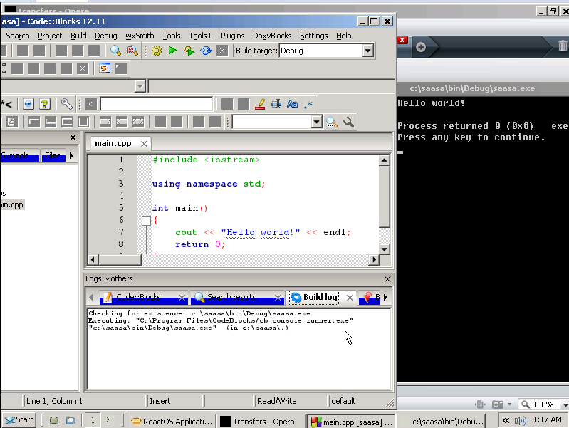
Screenshot
Notes:
All – 20 sec
Ok, I’m gonna move away from the architecture design, and speak about key components which the majority of people are interested in, and the state of these components in ReactOS.
Executive, including HAL, Kernel and device drivers
Win32 subsystem, comprising of both kernel and usermode components
The network model, from layer 2 to layer 7
GDI, windowing and the user interface
Gaming, provided by both DirectX and OpenGL.

Slide 7
Why ReactOS?
For companies stuck at Windows 2003
  Automation and so on
For users having issues with NT6+
  Hardware, look'n'feel, performances, ...
To free Windows API
  What do syscalls really do?

Slide 8
Who?
21 committers for 2013
Many more contributors
  Patches, translations, web and so on
Dedicated teams
  Dev, web, infra, PR
ReactOS Foundation driven
  Finances at ReactOS Deutschland e.V.

Slide 9
What ReactOS is not
Linux
  Written from scratch
Wine
  Even though there is a strong usage of Wine
Alone
  Interactions with several other FOSS projects
Finished

Slide 10
What to expect now?
A Win32 compatible OS
  That can run Firefox, Opera, Code::blocks, ...
A small and fast OS
  Can boot in a few seconds
Windows drivers support
  Enables hardware support
Crashes, bugs, incompatibilities

Slide 11
What to expect later?
A Win32 compatible OS
  Perhaps with support for Vista+ API
Several architectures support
  x86, x86_64, ARM7
Stability
Features that are not in Windows
  Multiple desktops?

Slide 12
Thanks for your attention!
Questions?
Notes:
Question time!
A demonstration of ReactOS!

